Slide 1
Programming with B4X
Lesson 9 – Classes
Anywhere Software
Feb 2021

Slide 2
Today you will learn
What is a Class?
What is an Object?
What are Attributes and Methods?
Create and use simple class with B4J.

Slide 3



What is a Class
then
then
Imagine One Student
Imagine Second Student
Imagine Third Student
then
then
then
then
then
then
then
then
then
then
then
then

Slide 4
What is a Class
Student
1 | Registry Number
2 | Name
3 | Surname
4 | Address
5 | Phone
6 | Email
At the same time, we need functions such as:
New Student Registration
Change Student Information
Student Transfer
Show Student Information
Delete Student
Notes:
From the above we conclude that essentially for students we have similar data and similar actions that we can apply to them. Grouping all student data and functions into an independent and single code is called class. Every student Called Object or Instance of the class. Also, the variables that characterize the student surname, Registry number etc. Called Properties and the functions Described Methods

Slide 5
What is a Class
We call class
the grouping of data and functions into a single and independent code.

Slide 6
Objects
Object or Instance
of the class are all independent elements that result from the use of the class.

Slide 7
Properties - Methods
Variables of an object are called properties.
The functions applied to an object are called methods.

Slide 8
Advantages
Some of the advantages of using classes are flexibility in the use of code, speed and ease in developing programs and reusing code in other programs.

Slide 9
Example of class in B4J
A library has a number of books which it lends to readers who subscribed in the library.
Each book has features such as title, author, publisher, year of publication.
Also, the Insert Book, Show Book Items, Change Book Items functions apply to each book.
Create an application in B4J that implements the Book class with the properties and methods mentioned above.

Slide 10
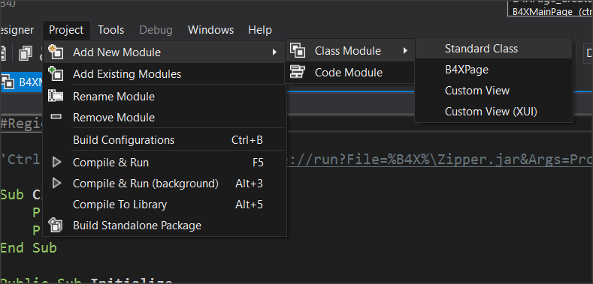
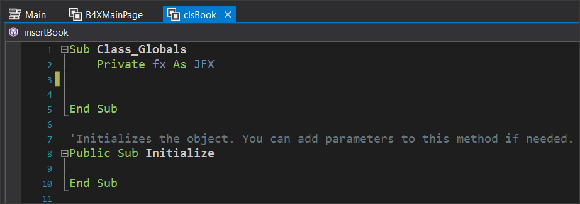
Example of class in B4J
Notes:
Create a new application B4XPages and give the name “library”.
From menu Project – Add New Module – Class Module menu select Standard Class.
In the dialog box, name clsBook (i.e. class Book)
A new code tab named clsBook will be created.

Slide 11
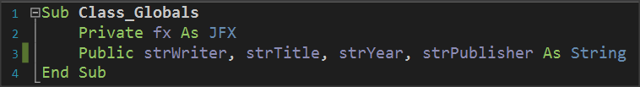
Adding Properties
a. Book Title
b. Author Name
c. Publisher
d. Release Date

Slide 12
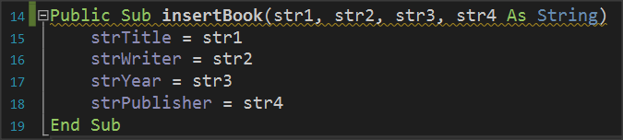
Implementing method insertBook
Notes:
This is a subprogram that accepts 4 string data as parameters and then assigns it in the order that it is inserted into the subprogram into the variables strTitle, strWiter, strYear, strPublisher.

Slide 13
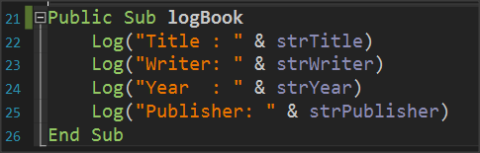
Implementing method logBook
Notes:
The subprogram displays with log command the properties of the Books class or in other words the variables that describe the class.

Slide 14
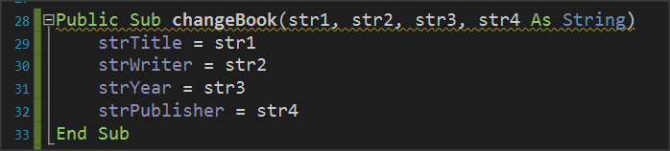
Implementing method changeBook
Notes:
The method of changing items accepts as parameters new elements for the class and changes the property values of the corresponding properties.

Slide 15
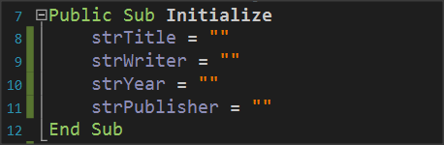
The Initialize method.
Notes:
The Initialize routine is used to give initial values to variables or do any other functions required when creating an object from a class.

Slide 16
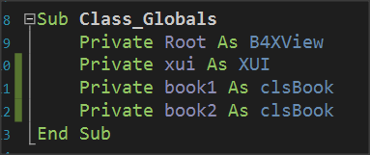

How to use class clsBook
Back to B4XMainPage
First create clsBook objects.

Slide 17
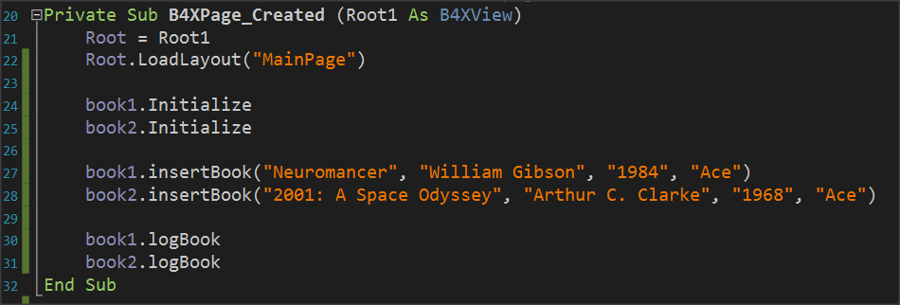
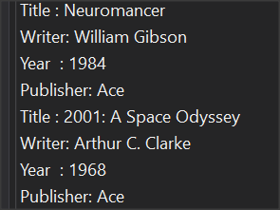
Using Methods
Initialize is not optional method. It’s the first method you must use before do anything with an object
Notes:
The InsertBook method then enters values for the two books in the object properties.
End the logbook method displays the contents of the properties of each book.
Each time you write an object name and pressing the period B4X displays a window with all available properties and methods of the class. The IsInitialized method checks whether the object is initialized and exists in all classes that you create.

Slide 18
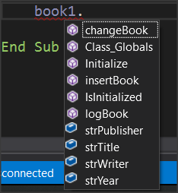
Remember
Each property can be called by writing the object name, then a period and the method name. Some methods need parameters to work while others don't.

Slide 19
Thank you!!!
Photos taken From:

